Slide 1

DSC 680 Term Project 2 Covid 19 Prediction
Anuj Tanwar
Bellevue University

Slide 2
Content
Introduction - Why do we need Covid 19 Predictions
How do I plan to predict Projections
Exploring data and trends
Data Modeling
Predictions
Conclusion
Source

Slide 3
Introduction – Why Predict COVID 19
Saves lives
Reduces impact on country’s economy
Can help healthcare sector to be prepared
Helps determine if lockdown is required
Helps supply chain in estimating demands on products like PPE, ventilators, sanitizer, masks, etc
Can help pharmaceutical companies in managing medicines and vaccine supplies.

Slide 4
How do I plan to Predict covid?
Collect Covid Data
Data Cleaning &
Pre-Processing
EDA (Exploratory Data Analysis)
Model Evaluation Process
Training of Model
Apply LSTM Model
Predictions
Training Dataset

Slide 5
How do I plan to Predict Covid Projections?
Used Datameet and Ministry of Health and Family Welfare Government of India.
Keys and values were read separately from JSON dataset and then combined into a dataframe
Data Cleaned by dropping duplicates, filtering outliers, taking care of nulls, etc.
Used Visualizations to understand the data better.
LSTM (Long short-term memory) was used for modelling.
Model accuracy was calculated by plotting predicted values Vs real values from test dateset.

Slide 6
Variables in the Dataset
report_date: Date
death_daily: Death count on the report_date
cured_daily: Number of cases cured on report_date
total_confirmed_cases_daily: Number of confirmed cases on report_date
total_vacc_cnt: Total number of vaccine counts on report_date
first_dose_cnt: Number of first dose count on report_date
second_dose_cnt: Number of second dose count on report_date

Slide 7
Exploratory Data Analysis
Joined case dataset with vaccine dataset to get additional information.
Handling missing values
Dropped features not useful for analysis
Transformed features
Dropped records with invalid values.
Handle NaNs.
Used MinMaxScaler() to rescale each column.
Exploring data using different Visualizations

Slide 8
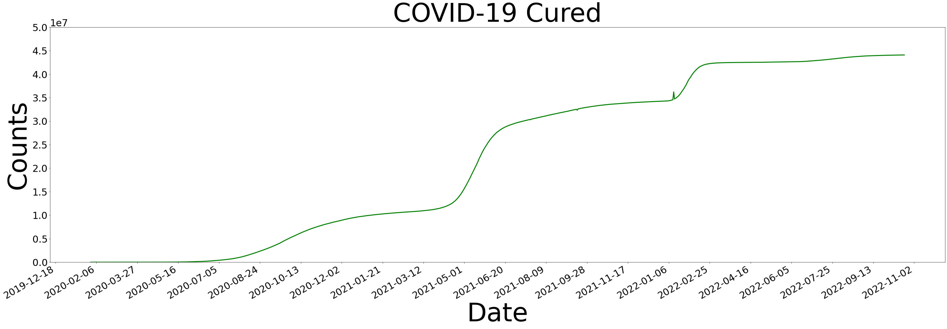
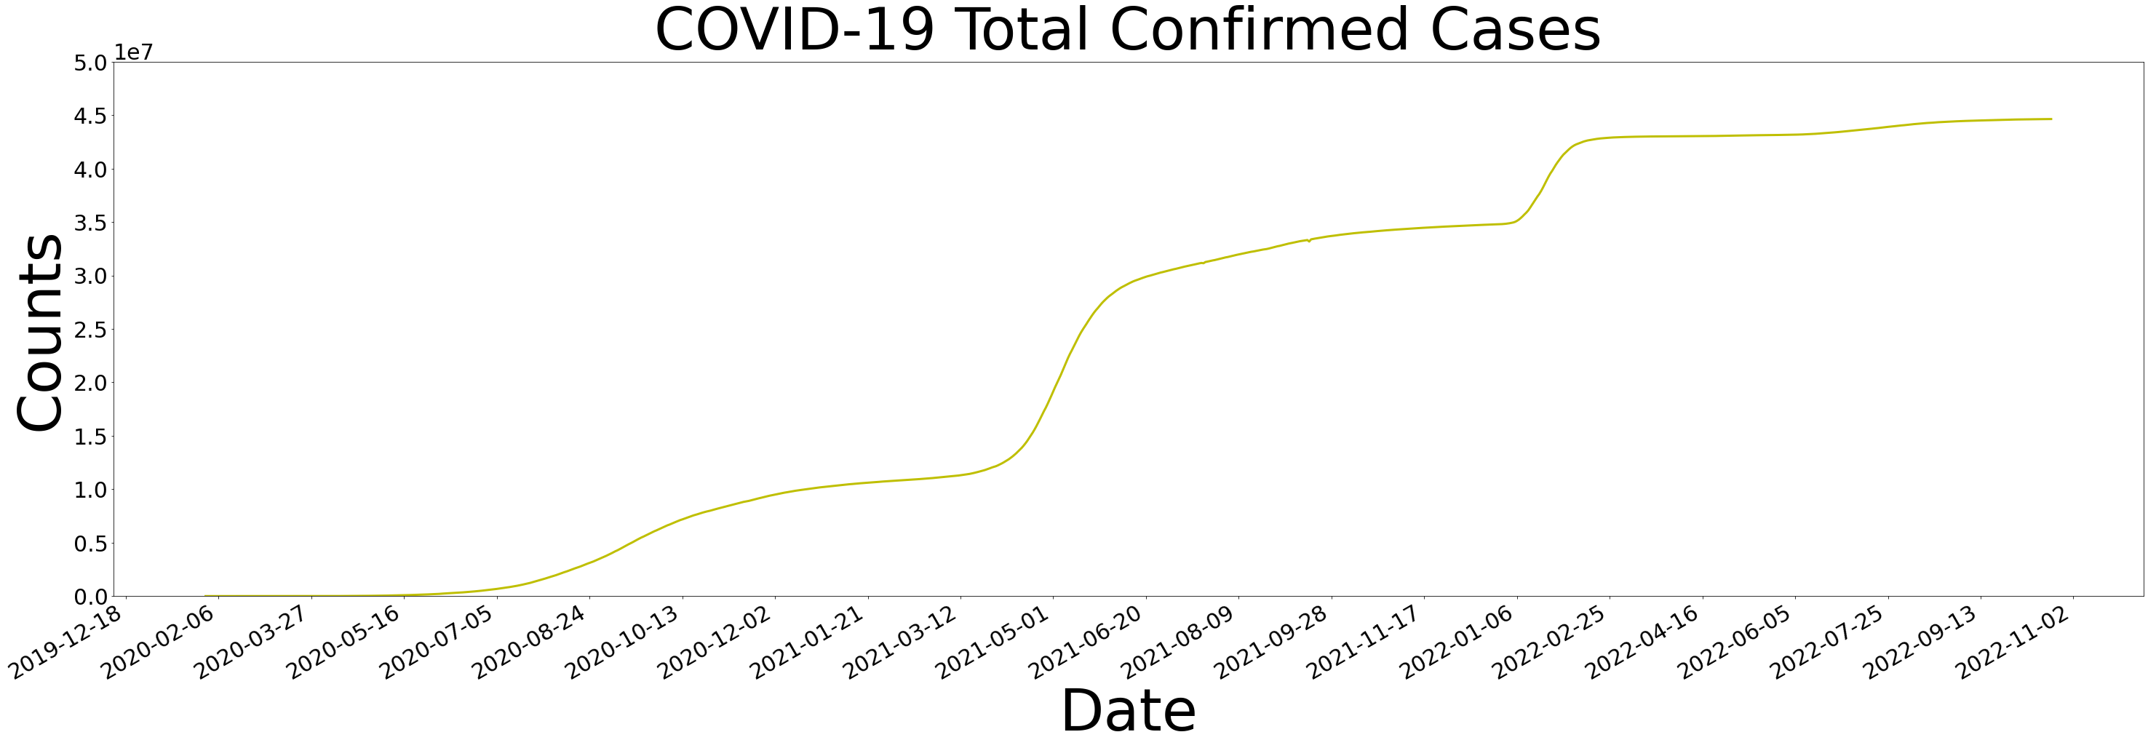
Time Series Plots

Slide 9
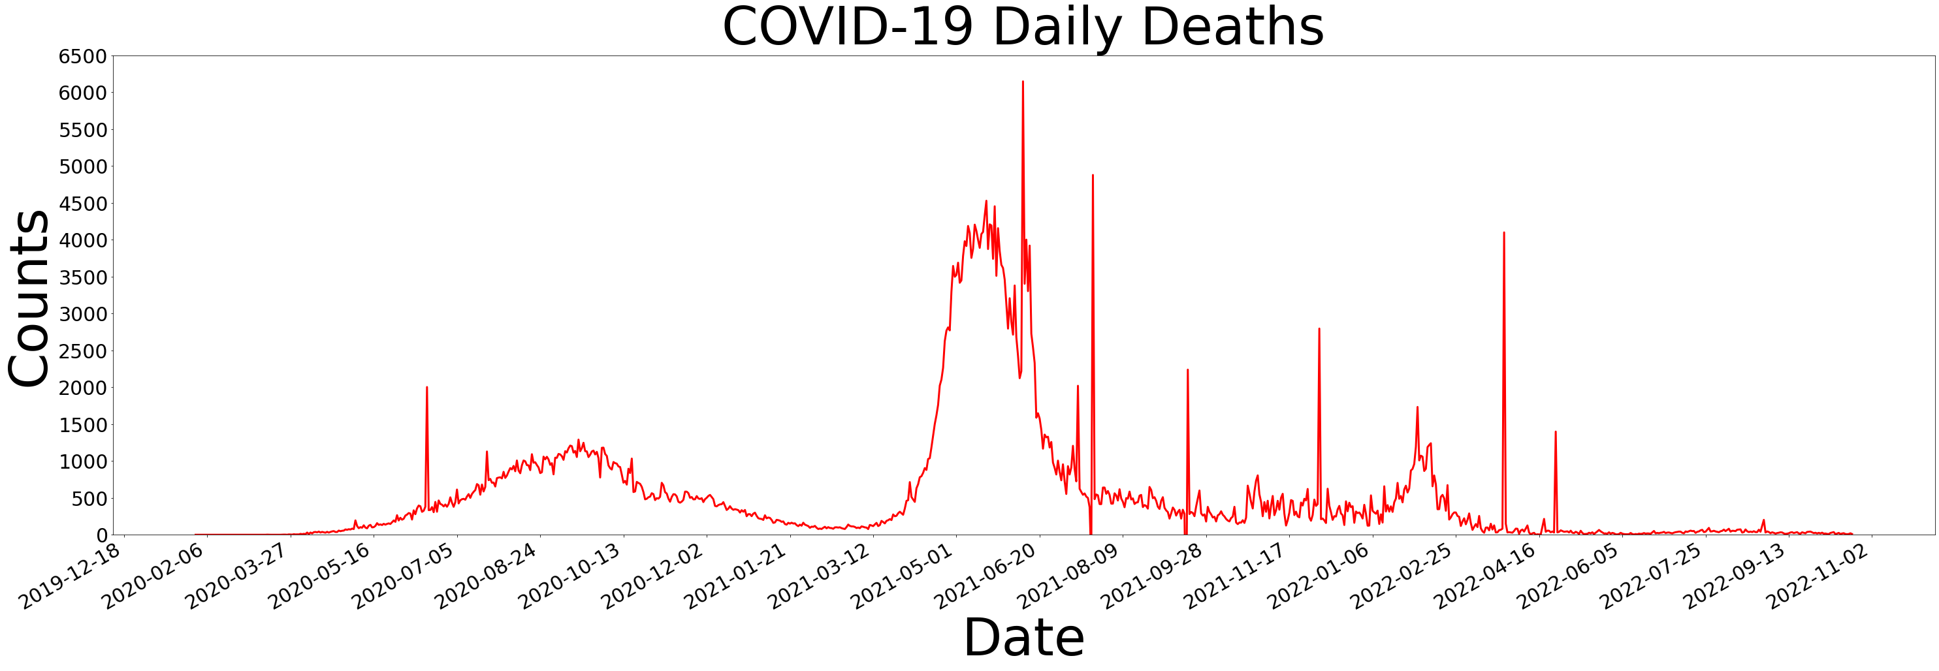
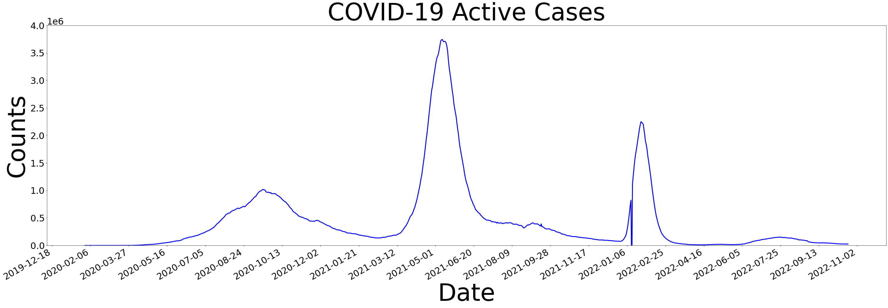
Time Series Plots - Continued

Slide 10
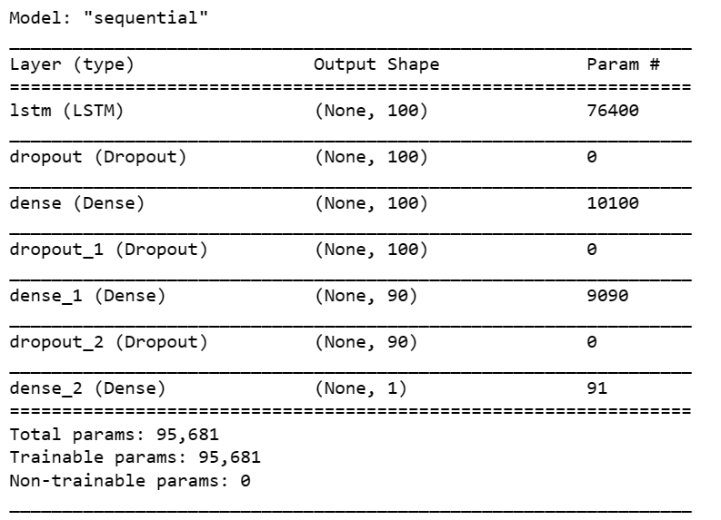
LTSM Modeling
LSTM was carried out on covid data.
Data was divided into test and train datasets. Picking 90 days as window size for time series.
For every 90th record in one list, the 91st record is the label
Daily confirmed cases field was considered to train the model.
Actual values and predicted values were plotted together.
Plot suggest Actual and Predicted values are close.

Slide 11
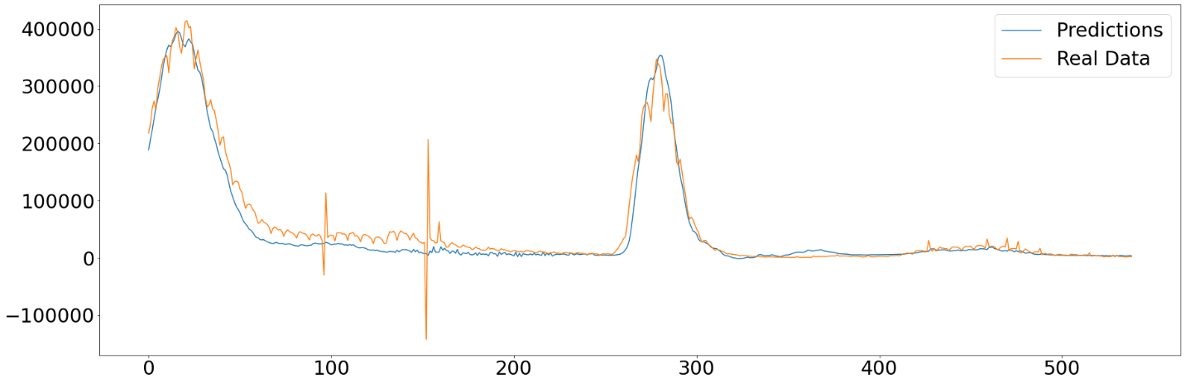
Predictions Vs Real Data
Prediction - Conclusion
Plot indicates our model predicts the values close to actual which means model is accurate.

Slide 12
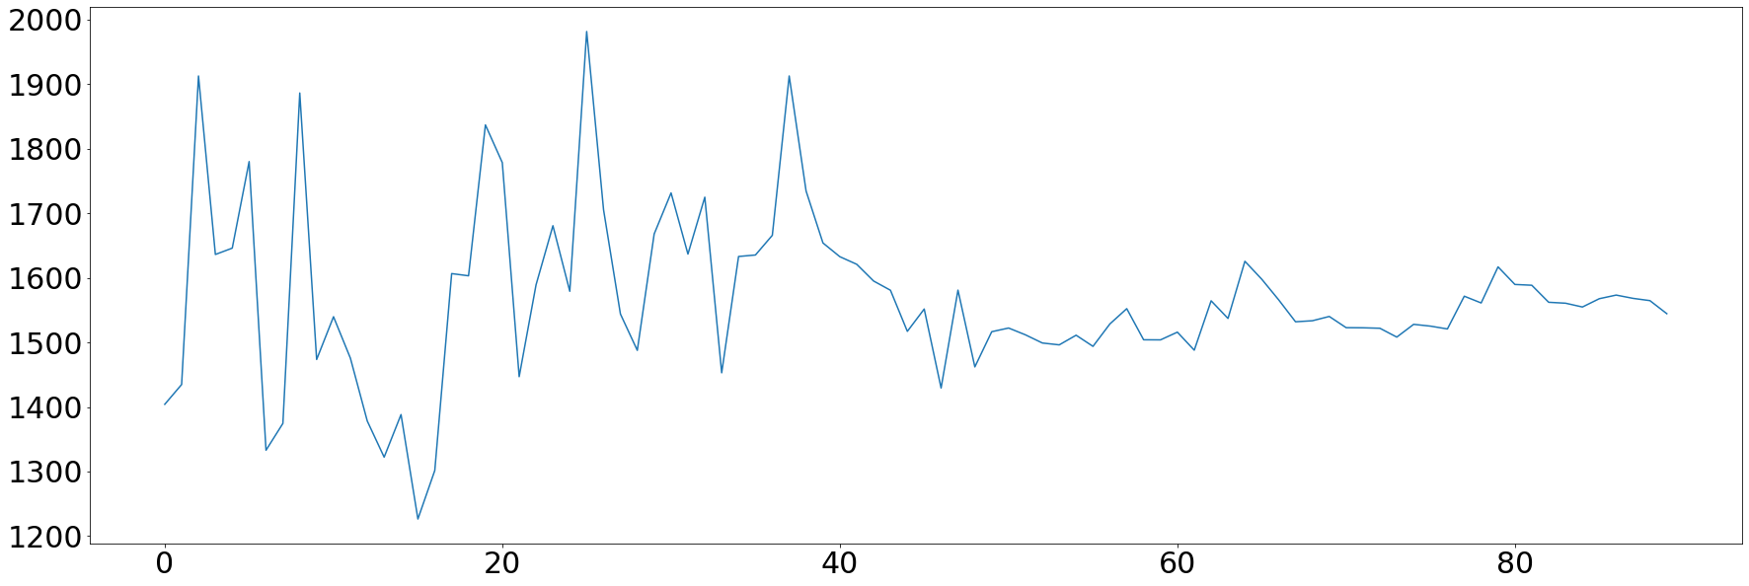
Predictions
90 Days Predictions
Above model predicts around 141k new covid cases in next 90 days.

Slide 13
Sources
Economic Impact of COVID-19 (2022, Feb 07) KFF. https://www.kff.org/global-health-policy/issue-brief/economic-impact-of-covid-19-on-pepfar-countries/
Datameet Covid 19 (2022, Oct 21) Github. https://github.com/datameet/covid19/tree/master/data
Covid 19 Positivity Rate (2023, Jan 27) MOHFW. https://www.mohfw.gov.in/

Slide 14
The End

